Slide 1
Regression
linear, logistics, reasons to choose and cautions, additional regression models.

Slide 2
Course Outcome
Develop regression model for data forecasting (PO-2) level-2
Notes:
As a result of this class, you will be able to...

Slide 3
Regression
relationship between one variable (termed the dependent variable) and one or more other variables (termed the independent variables).
A model for predicting one variable from another.

Slide 4
Models
A model is statistical or Non mathematical which represents some phenomenon
Notes:
3

Slide 5
What is a Math/Stats Model?
Often Describe Relationship between Variables
Types
    Deterministic Models (no randomness)
    Probabilistic Models (with randomness)
Notes:
.

Slide 6
Deterministic Models
Hypothesize Exact Relationships
Suitable When Prediction Error is Negligible
Example: Body mass index (BMI) is measure of body fat based
  Metric Formula: BMI = Weight in Kilograms
  (Height in Meters)²
  Non-metric Formula: BMI = Weight (pounds)x703
  (Height in inches)²

Slide 7
Probabilistic Models
Hypothesize 2 Components
    Deterministic
    Random Error
Example: Systolic blood pressure of newborns Is 6 Times the Age in days + Random Error
    SBP = 6xage(d) + ε
    Random Error May Be Due to Factors Other Than age in days (e.g. Birthweight)

Slide 8
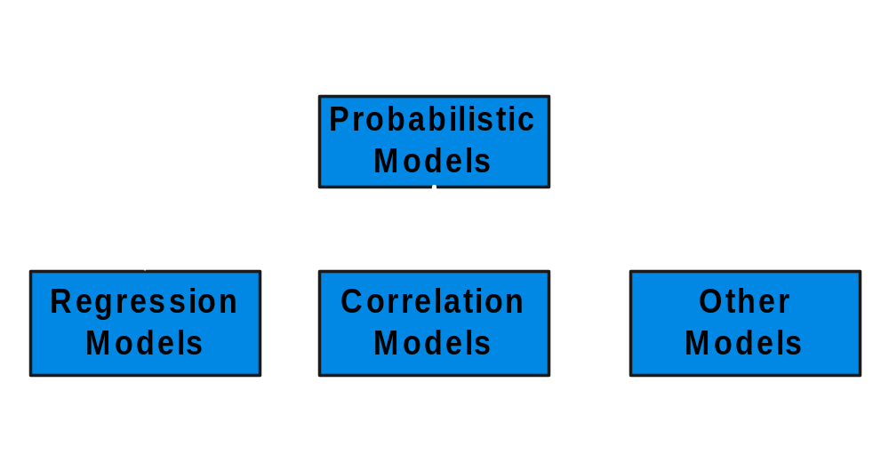
Types of
Probabilistic Models
Notes:
7

Slide 9
Regression Models
Relationship between one dependent variable and explanatory variable(s)
Use equation to set up relationship
    Numerical Dependent (Response) Variable
    1 or More Numerical or Categorical Independent (Explanatory) Variables
Used Mainly for Prediction & Estimation

Slide 10
Regression Models
Regression analysis is useful for answering the following kinds of questions:
What is a person's expected income?
What is the probability that an applicant will default on a loan?
Regression analysis is a useful explanatory tool that can identify the input variables that have the greatest statistical influence on the outcome.
Notes:
13

Slide 11
Regression Modeling Steps
1. Hypothesize Deterministic Component
    Estimate Unknown Parameters
2. Specify Probability Distribution of Random Error Term
    Estimate Standard Deviation of Error
3. Evaluate the fitted Model
4. Use Model for Prediction & Estimation

Slide 12
Model Specification
Notes:
13

Slide 13
Specifying the deterministic component
1. Define the dependent variable and independent variable
2. Hypothesize Nature of Relationship
  Expected Effects (i.e., Coefficients’ Signs)
  Functional Form (Linear or Non-Linear)
  Interactions

Slide 14
Thinking Challenge:
Which Is More Logical?
Skills required+CGPA
Skills required+CGPA
Years since admitted to University
Years since admitted to University
Skills required+CGPA
Skills required+CGPA
Years since admitted to University
Years since admitted to University
Notes:
17
With positive linear relationship, sales increases infinitely.
Discuss concept of ‘relevant range’.

Slide 15
Types of
Regression Models
Notes:
18
This teleology is based on the number of explanatory variables & nature of relationship between X & Y.

Slide 16
Types of
Regression Models
Regression
Models
Notes:
19
This teleology is based on the number of explanatory variables & nature of relationship between X & Y.

Slide 17
Types of
Regression Models
1 Explanatory
Regression
Variable
Models
Simple
Notes:
20
This teleology is based on the number of explanatory variables & nature of relationship between X & Y.

Slide 18
Types of
Regression Models
1 Explanatory
Regression
2+ Explanatory
Variable
Models
Variables
Simple
Multiple
Notes:
21
This teleology is based on the number of explanatory variables & nature of relationship between X & Y.

Slide 19
Types of
Regression Models
1 Explanatory
Regression
2+ Explanatory
Variable
Models
Variables
Simple
Multiple
Linear
Notes:
22
This teleology is based on the number of explanatory variables & nature of relationship between X & Y.

Slide 20
Types of
Regression Models
1 Explanatory
Regression
2+ Explanatory
Variable
Models
Variables
Simple
Multiple
Non-
Linear
Linear
Notes:
23
This teleology is based on the number of explanatory variables & nature of relationship between X & Y.

Slide 21
Types of
Regression Models
1 Explanatory
Regression
2+ Explanatory
Variable
Models
Variables
Simple
Multiple
Non-
Linear
Linear
Linear
Notes:
24
This teleology is based on the number of explanatory variables & nature of relationship between X & Y.

Slide 22
Types of
Regression Models
1 Explanatory
Regression
2+ Explanatory
Variable
Models
Variables
Simple
Multiple
Non-
Non-
Linear
Linear
Linear
Linear
Notes:
24
This teleology is based on the number of explanatory variables & nature of relationship between X & Y.

Slide 23
Linear Regression Model
Notes:
26

Slide 24
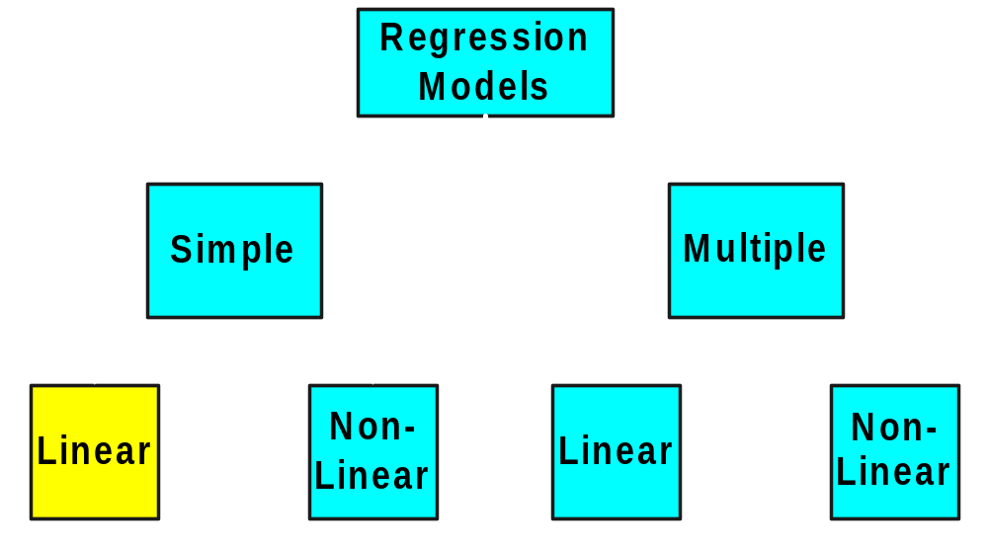
Types of
Regression Models
Diagram Ref: Dr Nazia
Notes:
27
This teleology is based on the number of explanatory variables & nature of relationship between X & Y.

Slide 25
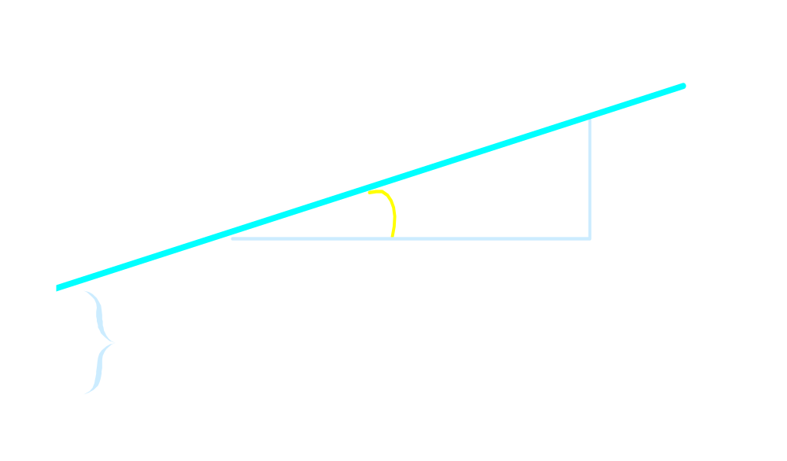

Linear Equations
© 1984-1994 T/Maker Co.
Notes:
28

Slide 26
Linear Regression Model
1. Relationship Between Variables Is a Linear Function
Population
Y-Intercept
Population Slope
Random Error
Y
=
β
+
β
X
+
ε
i
0
1
i
i
Dependent (Response) Variable
(e.g., CD+ c.)
Independent (Explanatory) Variable
(e.g., Years s. serocon.)

Slide 27
Population & Sample Regression Models
Notes:
30

Slide 28
Population & Sample Regression Models
Population
☺
☺
☺
☺
☺
Notes:
31

Slide 29

Population & Sample Regression Models
Population
Unknown Relationship
☺
☺
☺
☺
☺
Notes:
32

Slide 30
Population & Sample Regression Models
Population
Random Sample
Unknown Relationship
☺
☺
☺
☺
☺
☺
☺
Notes:
33

Slide 31
Population & Sample Regression Models
Population
Random Sample
Unknown Relationship
☺
☺
☺
☺
☺
☺
☺
Diagram Ref: Dr Nazia,VU Pune
Notes:
34

Slide 32
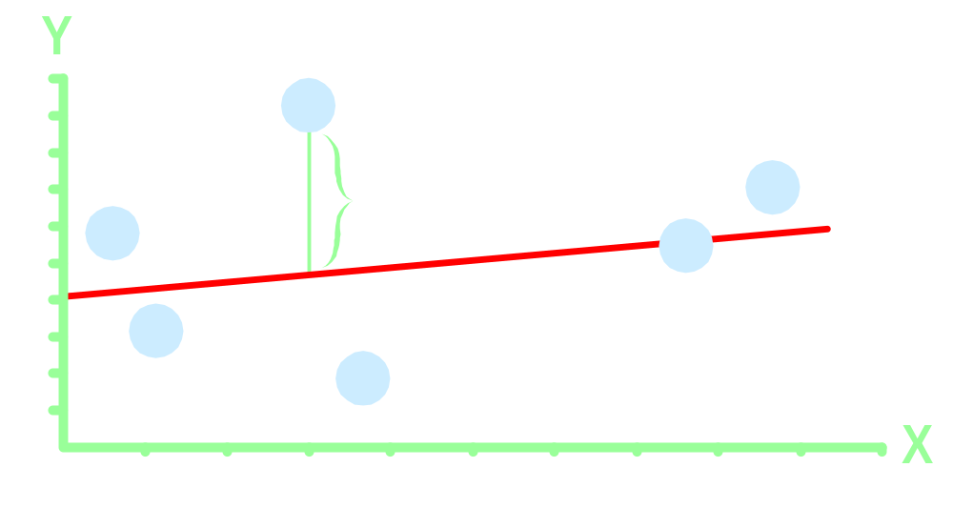
Population Linear Regression Model
Observedvalue
ε_{i} = Random error
Observed value
Notes:
35

Slide 33
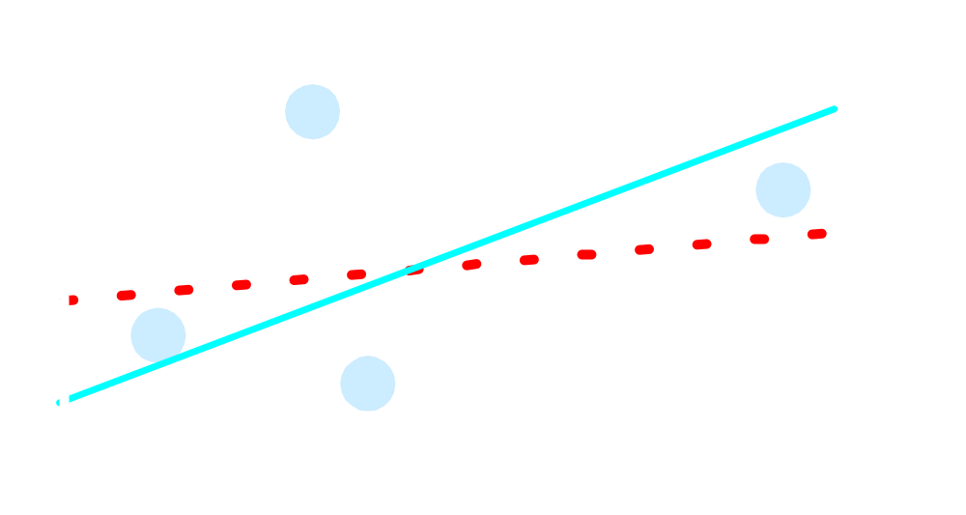
Sample Linear Regression Model
ε_{i} = Random error
^
Unsampled observation
Observed value
Notes:
36

Slide 34
Use cases
Real estate: to model residential home prices as a function of the home's living area.
set or evaluate the list price of a home on the market.
The model could be further improved by including other input variables such as number of bathrooms, number of bed rooms, lot size, school district rankings, crime statistics, and property taxes.

Slide 35
Demand forecasting:
Businesses and governments can use linear regression models to predict demand for goods and services.
Restaurant chains can appropriately prepare for the predicted type and quantity of food that customers will consume based upon the weather, the day of the week, whether an item is offered as a special, the time of day, and the reservation volume. Similar models can be built to predict retail sales, emergency room visits, and ambulance dispatches.

Slide 36
Can you add more parameters?
Consider a newly joined trainee Engineer searching a house in PUNE ( May be nearer to Hinjewadi)
Consider a newly married couple searching a house in popular area
Consider a family having school going kids shifted to Pune

Slide 37
Medical:
A linear regression model can be used to analyze the effect of a proposed radiation treatment on reducing tumor sizes. Input variables might include duration of a single radiation treatment, frequency of radiation treatment, and patient attributes such as age or weight.

Slide 38
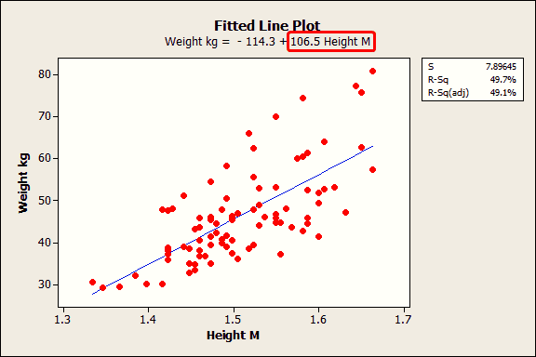
The coefficient indicates that for every additional meter in height you can expect weight to increase by an average of 106.5 kilograms.

Slide 39
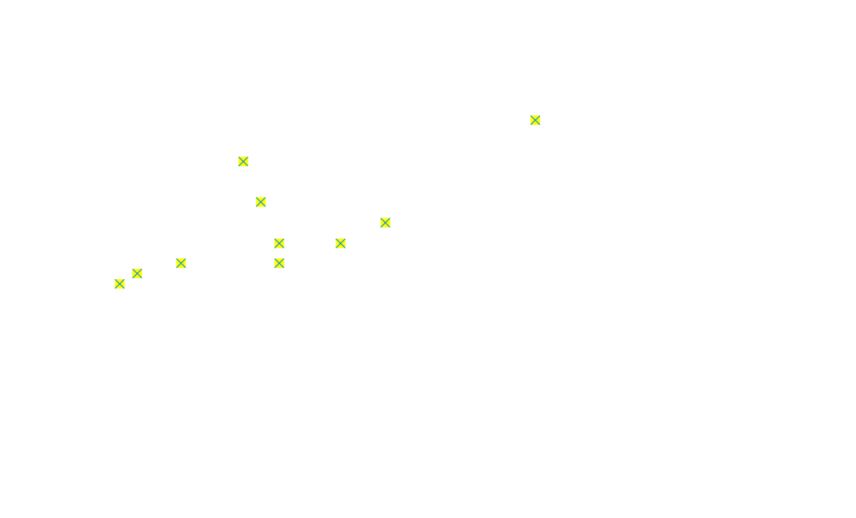
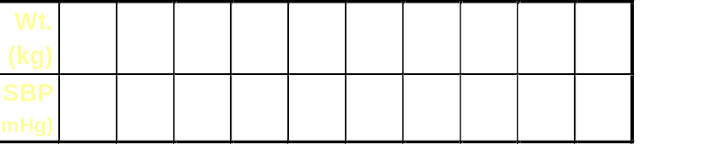
Scatter diagram of weight and systolic blood pressure

Slide 40
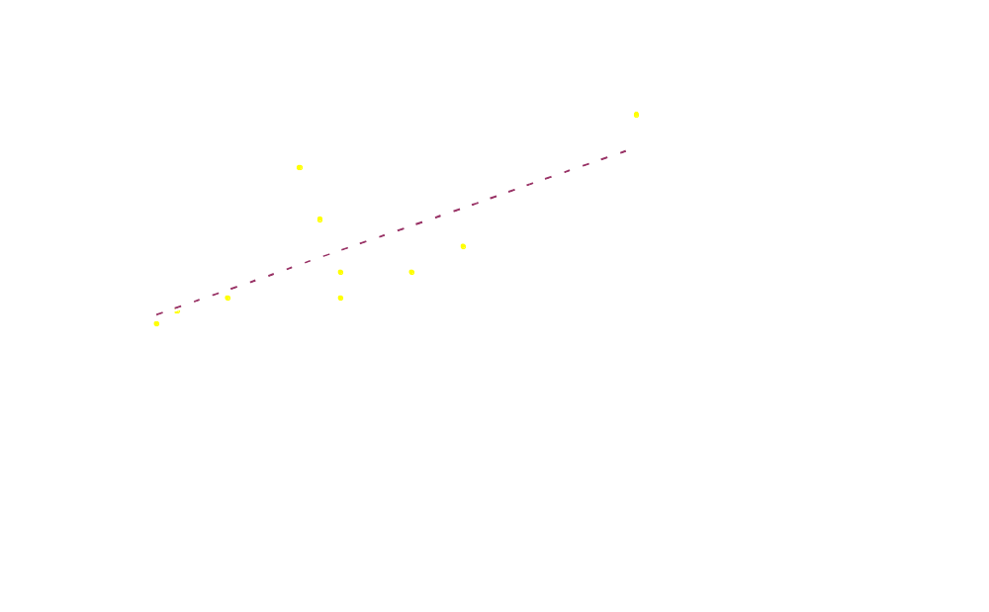
Scatter diagram of weight and systolic blood pressure

Slide 41
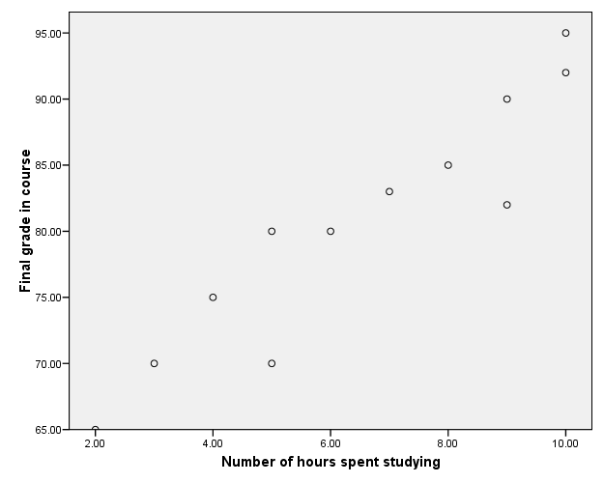
Positive relationship

Slide 42
Estimating Parameters:
Least Squares Method
Notes:
40

Slide 43
Scatter plot
1. Plot of All (X_{i}, Y_{i}) Pairs
2. Suggests How Well Model Will Fit
Y
60
40
20
0
X
0
20
40
60

Slide 44
Thinking Challenge
How would you draw a line through the points? How do you determine which line ‘fits best’?
Y
60
40
20
0
X
0
20
40
60
Notes:
42

Slide 45
Thinking Challenge
How would you draw a line through the points? How do you determine which line ‘fits best’?
Slope changed
Y
60
40
20
0
X
0
20
40
60
Intercept unchanged
Notes:
43

Slide 46
Thinking Challenge
How would you draw a line through the points? How do you determine which line ‘fits best’?
Slope unchanged
Y
60
40
20
0
X
0
20
40
60
Intercept changed
Notes:
44

Slide 47
Thinking Challenge
How would you draw a line through the points? How do you determine which line ‘fits best’?
Slope changed
Y
60
40
20
0
X
0
20
40
60
Intercept changed
Notes:
45

Slide 48
Least Squares
1. ‘Best Fit’ Means Difference Between Actual Y Values & Predicted Y Values Are a Minimum. But Positive Differences Off-Set Negative ones
ordinary least squares (OLS) or linear least squares is a method for estimating the unknown parameters in a linear regression model.
Notes:
49

Slide 49
Least Squares
1. ‘Best Fit’ Means Difference Between Actual Y Values & Predicted Y Values is a Minimum. But Positive Differences Off-Set Negative ones. So square errors!
Notes:
50

Slide 50
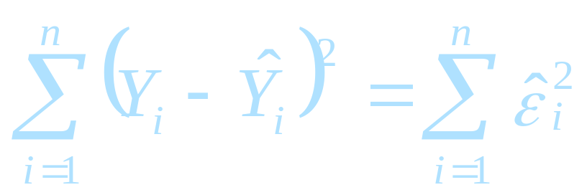
Least Squares
1. ‘Best Fit’ Means Difference Between Actual Y Values & Predicted Y Values Are a Minimum. But Positive Differences Off-Set Negative. So square errors!
2. LS Minimizes the Sum of the Squared Differences (errors) (SSE)
Notes:
51

Slide 51
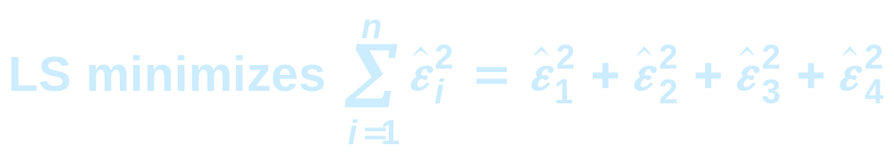
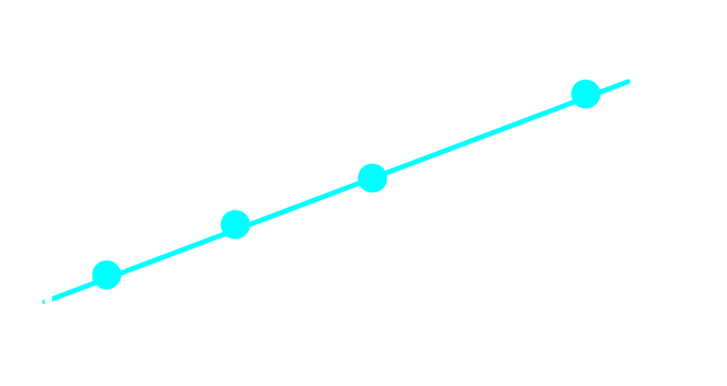
Least Squares Graphically
Notes:
52

Slide 52
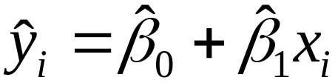
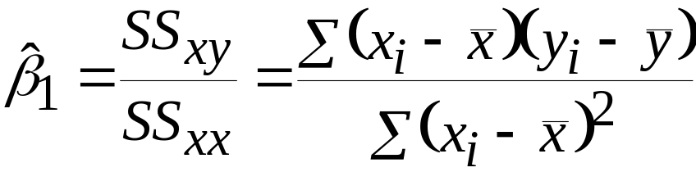
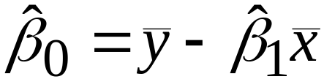
Coefficient Equations
Prediction equation
Sample slope
Sample Y - intercept

Slide 53
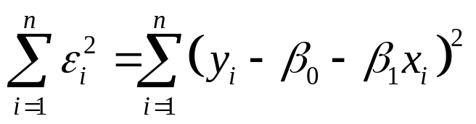
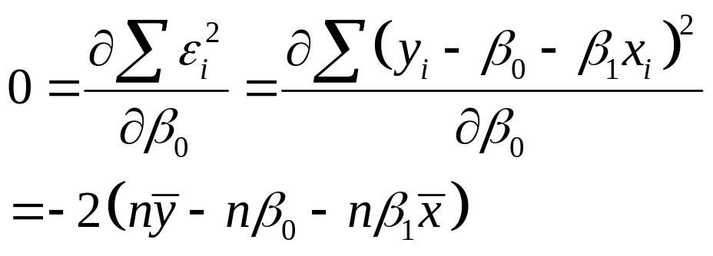
Derivation of Parameters (1)
Least Squares (L-S):
Minimize squared error

Slide 54
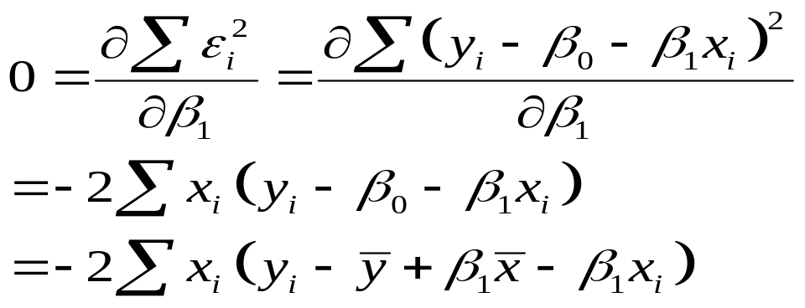
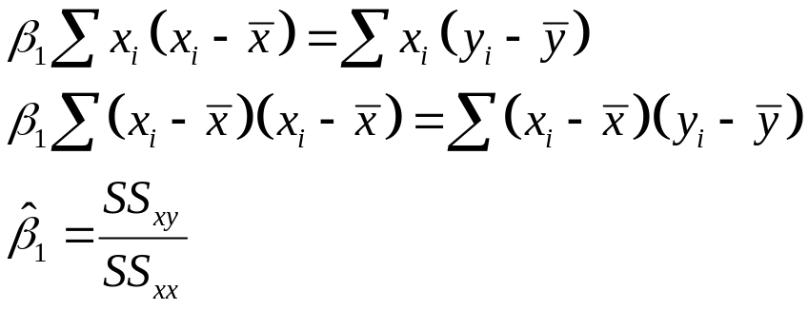
Derivation of Parameters (1)
Least Squares (L-S):
Minimize squared error

Slide 55
R code implementation
Sample R code implementation is given.
Students have to solve similar examples in Python
Students have to submit as a Lab Practise-3 Assignment .

Slide 56
Input Data
Below is the sample data representing the observations:
# Values of height
151, 174, 138, 186, 128, 136, 179, 163, 152, 131
# Values of weight.
63, 81, 56, 91, 47, 57, 76, 72, 62, 48
Example: Text book reference David Dietrich, Barry Hiller,

Slide 57
lm() Function
This function creates the relationship model between the predictor and the response variable.
Syntax
The basic syntax for lm() function in linear regression is:
lm(formula,data)
Following is the description of the parameters used:
formula is a symbol presenting the relation between x and y.
data is the vector on which the formula will be applied

Slide 58
Create Relationship Model & get the Coefficients
x <- c(151, 174, 138, 186, 128, 136, 179, 163, 152, 131)
y <- c(63, 81, 56, 91, 47, 57, 76, 72, 62, 48)
# Apply the lm() function.
relation <- lm(y~x)
print(relation)
When we execute the above code, it produces the following result:
Call:
lm(formula = y ~ x)
Coefficients:
(Intercept) x
-38.4551 0.6746

Slide 59
Get the Summary of the Relationship
x <- c(151, 174, 138, 186, 128, 136, 179, 163, 152, 131)
y <- c(63, 81, 56, 91, 47, 57, 76, 72, 62, 48)

Slide 60
# Apply the lm() function.
relation <- lm(y~x)
print(summary(relation))
When we execute the above code, it produces the following result:
Call:
lm(formula = y ~ x)
Residuals:
Min 1Q Median 3Q Max
-6.3002 -1.6629 0.0412 1.8944 3.9775
Coefficients:
Estimate Std. Error t value Pr(>|t|)
(Intercept) -38.45509 8.04901 -4.778 0.00139 **
x 0.67461 0.05191 12.997 1.16e-06 ***
---
Signif. codes: 0 ‘***’ 0.001 ‘**’ 0.01 ‘*’ 0.05 ‘.’ 0.1 ‘ ’ 1
Residual standard error: 3.253 on 8 degrees of freedom
Multiple R-squared: 0.9548, Adjusted R-squared: 0.9491
F-statistic: 168.9 on 1 and 8 DF, p-value: 1.164e-06

Slide 61
predict() Function
Syntax
The basic syntax for predict() in linear regression is:
predict(object, newdata)
Following is the description of the parameters used:
object is the formula which is already created using the lm() function.
newdata is the vector containing the new value for predictor variable.
Predict the weight of new persons
# The predictor vector.

Slide 62
x <- c(151, 174, 138, 186, 128, 136, 179, 163, 152, 131)
# The resposne vector.
y <- c(63, 81, 56, 91, 47, 57, 76, 72, 62, 48)
# Apply the lm() function.
relation <- lm(y~x)
# Find weight of a person with height 170.
a <- data.frame(x=170)
result <- predict(relation,a)
print(result)
When we execute the above code, it produces the following result:
1
76.22869

Slide 63
Visualize the Regression Graphically
# Create the predictor and response variable.
x <- c(151, 174, 138, 186, 128, 136, 179, 163, 152, 131)
y <- c(63, 81, 56, 91, 47, 57, 76, 72, 62, 48)
relation <- lm(y~x)
# Give the chart file a name.
png(file = "linearregression.png")
# Plot the chart.
plot(y,x,col="blue",main="Height & Weight Regression",
abline(lm(x~y)),cex = 1.3,pch=16,xlab="Weight in Kg",ylab="Height in cm")
# Save the file.
dev.off()

Slide 64
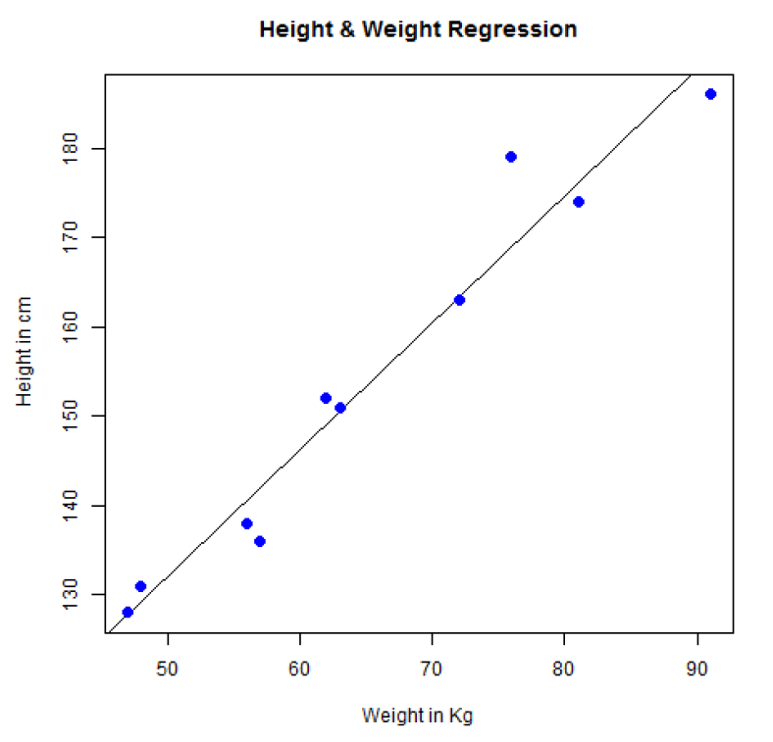
Output

Slide 65
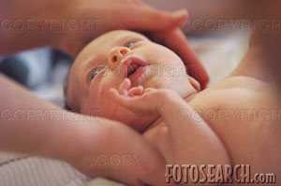
Example(Parameter Estimation)
Obstetrics: What is the relationship between
Mother’s Estriol level & Birthweight using the following data?
Estriol Birthweight
(mg/24h) (g/1000)
1 1
2 1
3 2
4 2
5 4
Example reference: Dr Nazia,VU pune

Slide 66

Scatterplot
Birthweight vs. Estriol level
Birthweight
Estriol level
Notes:
57

Slide 67
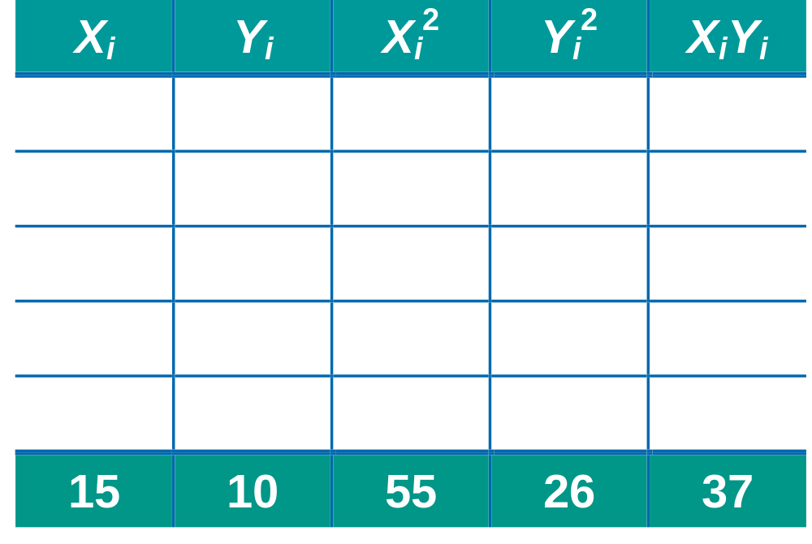
Parameter Estimation Solution Table
Notes:
58

Slide 68
Parameter Estimation Solution
Notes:
59

Slide 69
Coefficient Interpretation Solution

Slide 70
Coefficient Interpretation Solution
^
1. Slope (β₁)
  Birthweight (Y) Is Expected to Increase by .7 Units for Each 1 unit Increase in Estriol (X)

Slide 71
Coefficient Interpretation Solution
^
1. Slope (β₁)
  Birthweight (Y) Is Expected to Increase by .7 Units for Each 1 unit Increase in Estriol (X)
2. Intercept (β₀)
  Average Birthweight (Y) Is -.10 Units When Estriol level (X) Is 0
    Difficult to explain
    The birthweight should always be positive
^

Slide 72
Parameter Estimation
SAS Computer Output
Parameter Estimates
Parameter Standard
Variable DF Estimate Error t Value Pr > |t|
Intercept 1 -0.10000 0.63509 -0.16 0.8849
Estriol 1 0.70000 0.19149 3.66 0.0354
^
^
β₀
β₁

Slide 73

Parameter Estimation Thinking Challenge
You’re a Vet epidemiologist for the county cooperative. You gather the following data:
Food (lb.) Milk yield (lb.)
4 3.0
6 5.5
10 6.5
12 9.0
What is the relationship
between cows’ food intake and milk yield?
© 1984-1994 T/Maker Co.
Notes:
62

Slide 74

Scattergram
Milk Yield vs. Food intake*
M. Yield (lb.)
Food intake (lb.)
Notes:
65

Slide 75
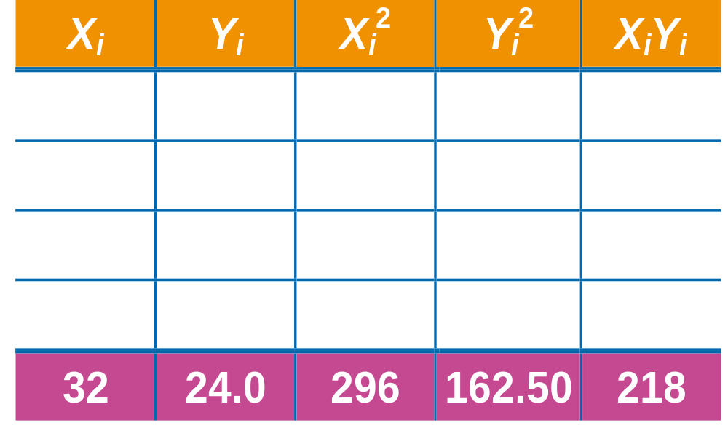
Parameter Estimation Solution Table*
Notes:
66

Slide 76
Parameter Estimation Solution*
Notes:
67

Slide 77
Coefficient Interpretation Solution*

Slide 78
Coefficient Interpretation Solution*
^
1. Slope (β₁)
  Milk Yield (Y) Is Expected to Increase by .65 lb. for Each 1 lb. Increase in Food intake (X)

Slide 79
Coefficient Interpretation Solution*
^
1. Slope (β₁)
  Milk Yield (Y) Is Expected to Increase by .65 lb. for Each 1 lb. Increase in Food intake (X)
2. Y-Intercept (β₀)
  Average Milk yield (Y) Is Expected to Be 0.8 lb. When Food intake (X) Is 0
^

Slide 80
Logistic regression
  It is often used because the relationship between the DV (a discrete variable) and a predictor is non-linear
  E.g. the probability of heart disease changes very little with a ten-point difference among people with low-blood pressure, but a ten point change can mean a drastic change in the probability of heart disease in people with high blood-pressure.

Slide 81
Use Cases
Medical: Develop a model to determine the likelihood of a patient's successful response to a specific medical treatment or procedure. Input variables could include age, weight, blood pressure, and cholesterol levels.
Example: Text book reference David Dietrich, Barry Hiller,

Slide 82
Finance: Using a loan applicant 's credit history and the details on the loan, determine the probability that an applicant will default on the loan. Based on the prediction, the loan can be approved or denied, or the terms can be modified.
Marketing: Determine a wireless customer's probability of switching carriers (known as churning) based on age, number of family members on the plan, months remaining on the existing contract, and social network contacts. With such insight, target the high-probability customers with appropriate offers to prevent churn.
Engineering: Based on operating conditions and various diagnostic measurements, determine the probability of a mechanical part experiencing a malfunction or failure. With th is probability estimate, schedule the appropriate preventive maintenance activity.

Slide 83

Model Description
Logistic regression is based on the logistic function f(y), as given in Equation,

Slide 84
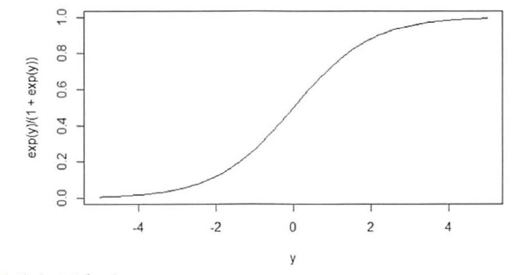
The Logistic Function

Slide 85

Because the range of f(y) is (0, 1), the logistic function appears to be an appropriate function to model the probability of a particular outcome occurring.
As the value of y increases, the probability of the outcome occurring increases.
In any proposed model, to predict the likelihood of an outcome, y needs to be a function of the input variables. In logistic regression, y is expressed as a linear function of the input variables.
In other words, the formula shown in following Equation (1)applies.

Slide 86

Then, based on the input variables x1,x2, …..xp-1, the probability of an event is shown in Equation(2)

Slide 87


Equation (1)comparable to following Equation used in linear regression modeling.
However, one difference is that the values of y are not directly observed.
Only the value of f(y) in terms of success or failure (typically expressed as 1 or 0, respectively) is observed.
Using p to denote f(y), Equation (2) can be rewritten in the form provided in following Equation (3)

Slide 88
The quantity
In Equation (3) is known as the log odds ratio, or the log it of p.
Techniques such as Maximum Likelihood Estimation (MLE) are used to estimate the model parameters.
MLE determines the values of the model parameters that maximize the chances of observing the given dataset.

Slide 89
Equation
The general mathematical equation for logistic regression is:
y = 1/(1+e^-(a+b1x1+b2x2+b3x3+...))
Following is the description of the parameters used:
y is the response variable.
x is the predictor variable.
a and b are the coefficients which are numeric constants.
The function used to create the regression model is the glm() function.

Slide 90
Example
The in-built data set "mtcars" describes different models of a car with their various engine specifications.
In "mtcars" data set, the transmission mode (automatic or manual) is described by the column am which is a binary value (0 or 1).
We can create a logistic regression model between the columns "am" and 3 other columns - hp, wt and cyl.
# Select some columns form mtcars.
input <- mtcars[,c("am","cyl","hp","wt")]
print(head(input))

Slide 91
When we execute the above code, it produces the following result:
am cyl hp wt
Mazda RX4 1 6 110 2.620
Mazda RX4 Wag 1 6 110 2.875
Datsun 710 1 4 93 2.320
Hornet 4 Drive 0 6 110 3.215
Hornet Sportabout 0 8 175 3.440
Valiant 0 6 105 3.460

Slide 92
Create Regression Model
We use the glm() function to create the regression model and get its summary for analysis.
input <- mtcars[,c("am","cyl","hp","wt")]
am.data = glm(formula=am ~ cyl + hp + wt ,
data=input,
family=binomial)
print(summary(am.data))

Slide 93
When we execute the above code, it produces the following result:
Call:
glm(formula = am ~ cyl + hp + wt, family = binomial, data = input)
Deviance Residuals:
Min 1Q Median 3Q Max
-2.17272 -0.14907 -0.01464 0.14116 1.27641
Coefficients:
Estimate Std. Error z value Pr(>|z|)
(Intercept) 19.70288 8.11637 2.428 0.0152 *
cyl 0.48760 1.07162 0.455 0.6491
hp 0.03259 0.01886 1.728 0.0840 .
wt -9.14947 4.15332 -2.203 0.0276 *
---
Signif. codes: 0 ‘***’ 0.001 ‘**’ 0.01 ‘*’ 0.05 ‘.’ 0.1 ‘ ’ 1
(Dispersion parameter for binomial family taken to be 1)

Slide 94
Null deviance: 43.2297 on 31 degrees of freedom
Residual deviance: 9.8415 on 28 degrees of freedom
AIC: 17.841
Number of Fisher Scoring iterations: 8
Conclusion
In the summary as the p-value in the last column is more than 0.05 for the variables "cyl“ and "hp", we consider them to be insignificant in contributing to the value of the variable "am". Only weight (wt) impacts the "am" value in this regression model.

Slide 95
Reasons to choose and cautions
Linear regression is suitable when the input variables are continuous or discrete, including categorical data types, but the outcome variable is continuous. If the outcome variable is categorical, logistic regression is a better choice.
Both models assume a linear additive function of the input variables. If such an assumption does not hold true, both regression techniques perform poorly.
Furthermore, in linear regression, the assumption of normally distributed error terms with a constant variance is important for many of the statistical inferences that can be considered. If the various assumptions do not appear to hold, the appropriate transformations need to be applied to the data.

Slide 96
Although a collection of input variables may be a good predictor for the outcome variable, the analyst should not infer that the input variables directly cause an outcome.
For example, it may be identified that those individuals who have regular dentist visits may have a reduced risk of heart attacks.
However, simply sending someone to the dentist almost certainly has no effect on that person's chance of having a heart attack.
It is possible that regular dentist visits may indicate a person's overall health and dietary choices, which may have a more direct impact on a person's health.

Slide 97
This example illustrates the commonly known expression, "Correlation does not imply causation.“
Use caution when applying an already fitted model to data that falls outside the dataset used to train the model. The linear relationship in a regression model may no longer hold at values outside the training dataset.
For example, if income was an input variable and the values of income ranged from $35,000 to $90,000, applying the model to incomes well outside those incomes could result in inaccurate estimates and predictions.

Slide 98
If several of the input variables are highly correlated to each other, the condition is known as multicollinearity.
Multicollinearity can often lead to coefficient estimates that are relatively large in absolute magnitude and may be of inappropriate direction (negative or positive sign).
When possible, the majority of these correlated variables should be removed from the model or replaced by a new variable that is a function of the correlated variables.
For example, in a medical application of regression, height and weight may be considered important input variables, but these variables tend to be correlated.
In this case, it may be useful to use the Body Mass Index (BMI), which is a function of a person's height and weight.

Slide 99

where weight is in kilograms and height is in meters.
However, in some cases it may be necessary to use the correlated variables. The next section provides some techniques to address highly correlated variables.

Slide 100
Additional regression models.
In the case of multicollinearity, it may make sense to place some restrictions on the magnitudes of the estimated coefficients.
Ridge regression, which applies a penalty based on the size of the coefficients, is one technique that can be applied.
In fitting a linear regression model, the objective is to find the values of the coefficients that minimize the sum of the residuals squared.
In ridge regression, a penalty term proportional to the sum of the squares of the coefficients is added to the sum of the residuals squared.

Slide 101
Lasso regression is a related modeling technique in which the penalty is proportional to the sum of the absolute values of the coefficients.
Only binary outcome variables were examined in the use of logistic regression.
If the outcome variable can assume more than two states, multinomial logistic regression can be used.

Slide 102
Summary
The use of linear regression and logistic regression to model historical data and to predict future outcomes.
Although regression analysis is relatively straightforward to perform using many existing software packages, considerable care must be taken in performing and interpreting a regression analysis.

